Slide 1
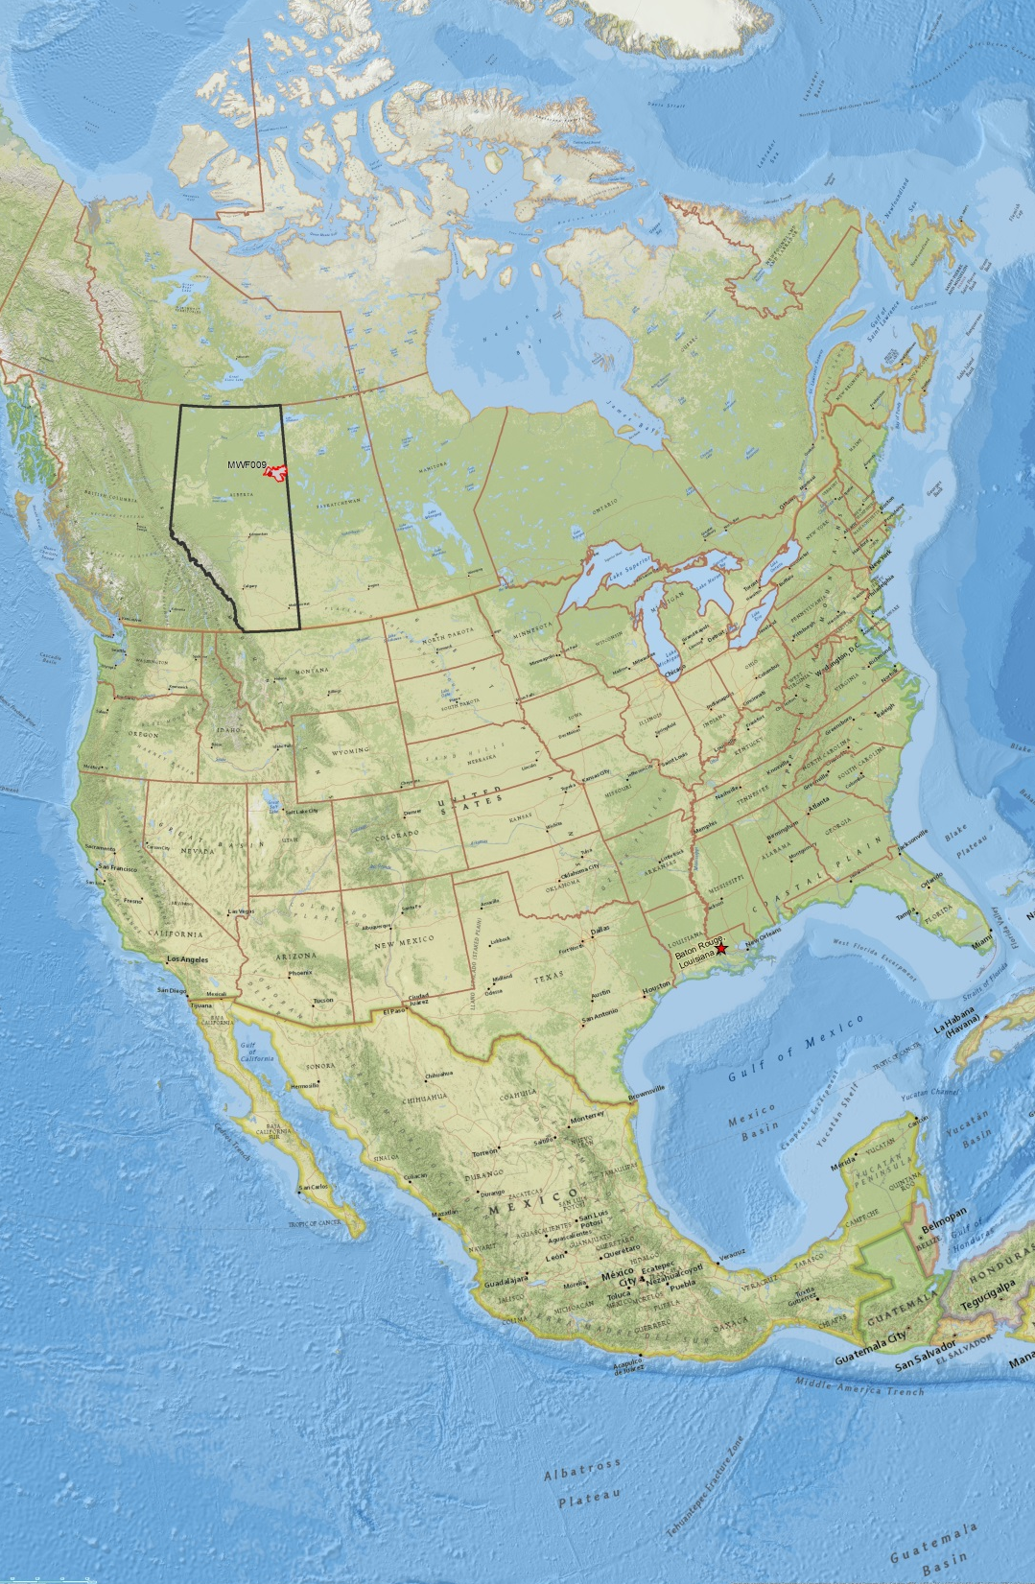
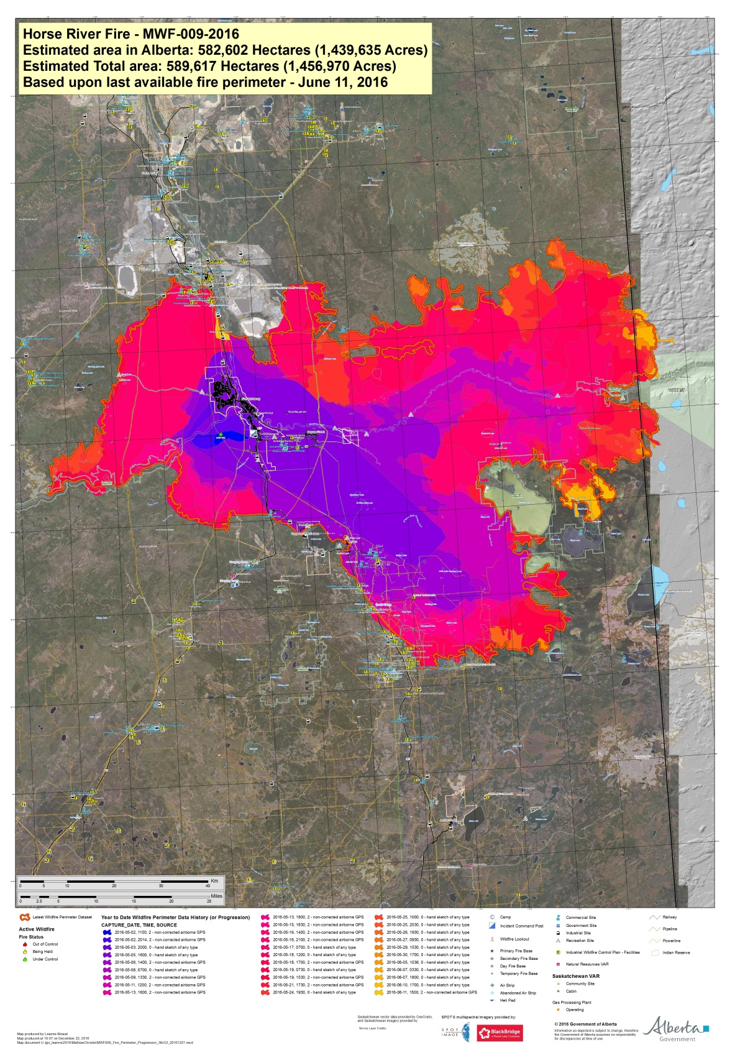

Slide 2
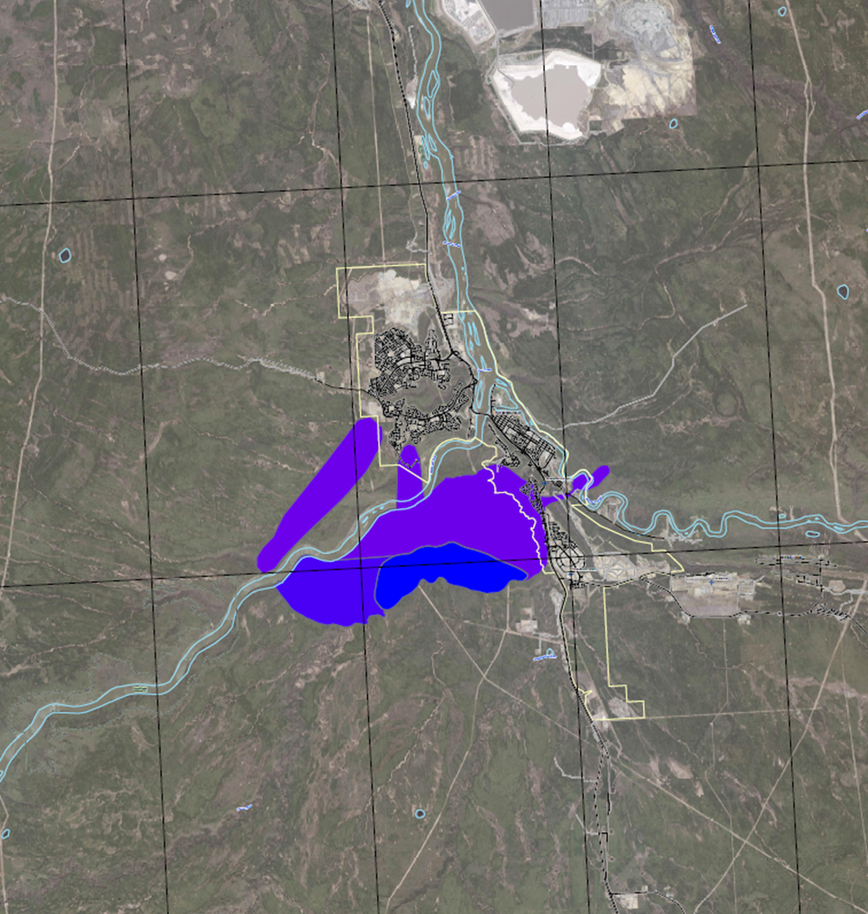
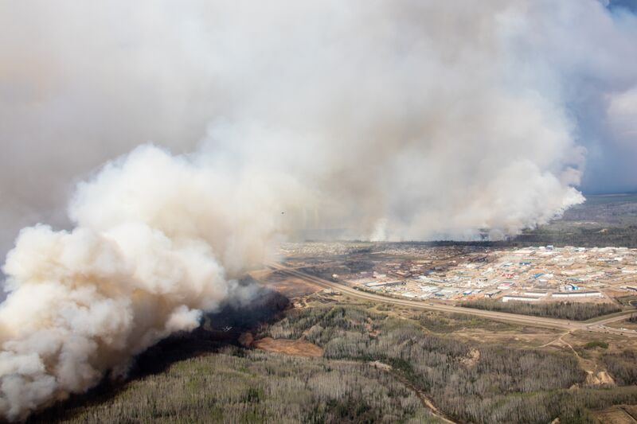
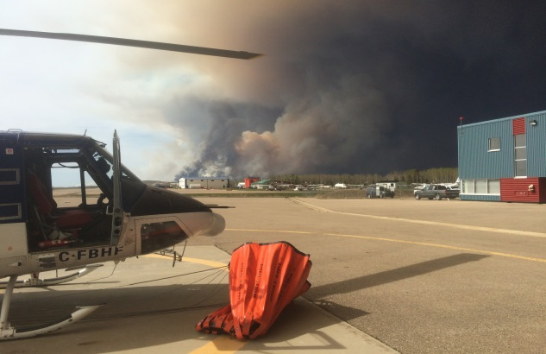
Horse River Fire
started
May 1, 2016
Fire Size
May 1 300 acres
May 2 6,500 acres
May 4 18,600 acres
Fire enters Fort McMurray
City of
Fort McMurray
May 4, 2016

Slide 3
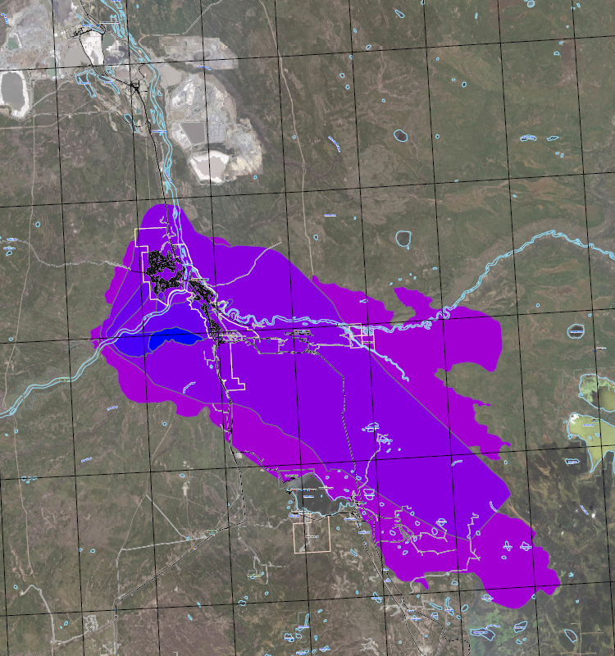
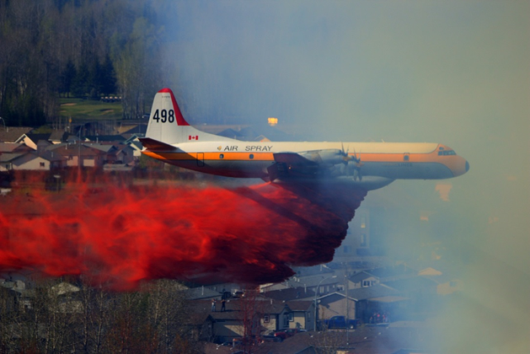
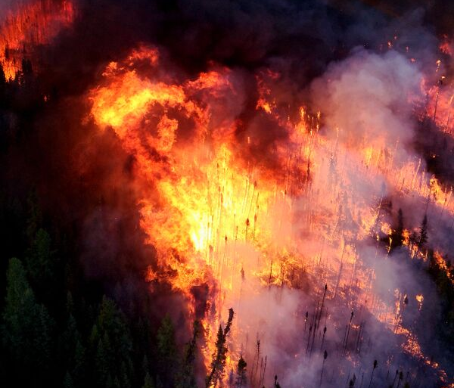
Horse River Fire
started
May 1, 2016
Fire Size
May 1 300 acres
May 2 6,500 acres
May 4 18,600 acres
May 5 210,000 acres
May 6 387,000 acres
May 6, 2017

Slide 4
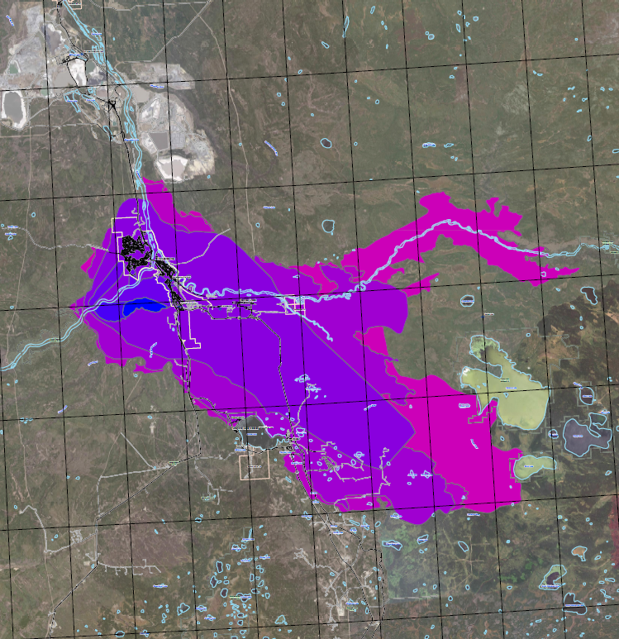
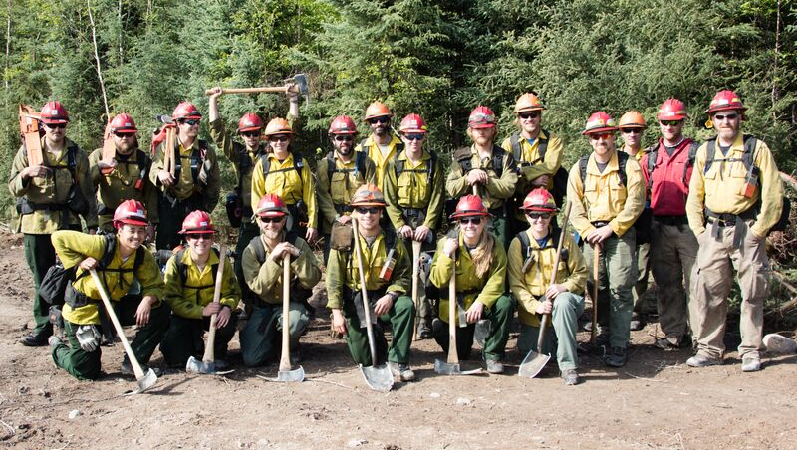
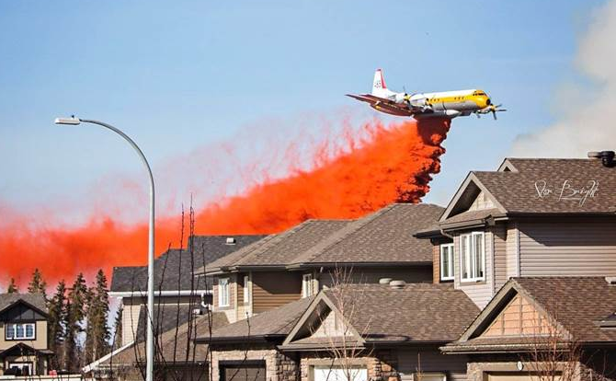
Horse River Fire
started
May 1, 2016
Fire Size
May 1 300 acres
May 2 6,500 acres
May 4 18,600 acres
May 5 210,000 acres
May 6 387,000 acres
May 8 398,000 acres
May 9 566,000 acres
May 9, 2016

Slide 5
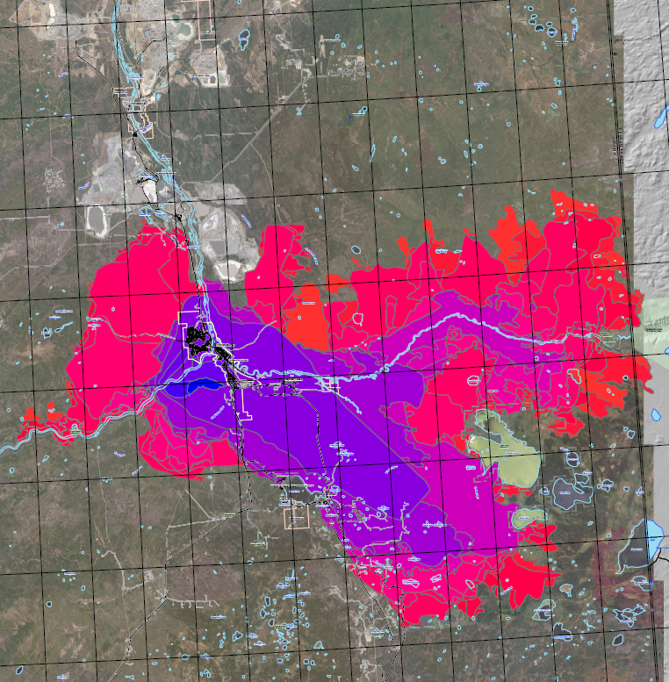
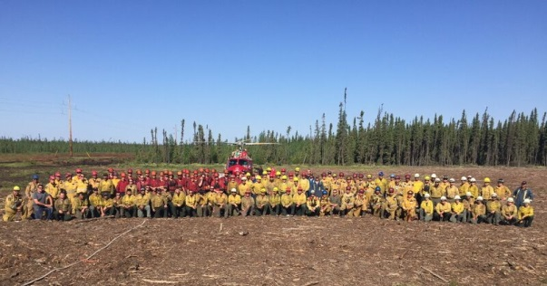
Horse River Fire
started
May 1, 2016
Fire Size
May 1 300 acres
May 2 6,500 acres
May 4 18,600 acres
May 5 210,000 acres
May 6 387,000 acres
May 8 398,000 acres
May 9 566,000 acres
May 16 702,300 acres
May 17 1,050,000 acres
May 18 1,194,000 acres
May 19 1,245,000 acres
May 21 1,292,000 acres
May 26 1,417,000 acres
June 29 1,456,815 acres
May 24, 2016
1,399,081 acres

Slide 6
